Slide 1
Module 2 Active Directory Threats Landscape
Section 4 - Security Configuration and Monitoring
June 2018

Slide 2
Agenda
01
Security Configuration Let’s see how to manage and deploy a security baseline on Windows Servers and domain controllers
05
Event forwarding Let’s see what we can do to gather and report specific events on a large number of systems.
02
Windows and Active Directory audit The bases of Windows auditing and how to configure it.
03
Events We are having a look at some events worth collecting and why.
04
Log management Event logs can be quite verbose. In this part we are looking at some of the options and limitation when it comes to manage the event logs.

Slide 3
Security Configuration
Why aren’t the default settings of the OS the most secure setting?
Compatibility
Service continuity
Some settings do change their default value
No more anonymous LDAP binds starting Windows Server 2003
LM storage is disabled by default since Windows Server 2008
Kerberos DES is disabled by default since Windows Server 2008 R2
NSPI calls are limited to 50 per account…
Notes:
Many organizations have been using AD for a very long time (almost 20 years). As a result, changing the default setting of a component can put the stability of the entire system in jeopardy .
Although some of the settings are open to ensure a better compatibility with the existing applications, Microsoft does publish guidelines and baselines for each of the security settings of the operating systems.

Slide 4
Security Baselines
Microsoft publishes security baselines per OS
The settings of the baselines have to be reviewed one by one to determine the impacts
Microsoft provides a toolset to compare the current settings: Microsoft Security Compliance Toolkit
It contains… the baselines
A tool to extract the local settings and registry settings of a machine
A tool to compare the local settings and GPO settings with the baseline
You can use this toolset to identify what to change and then apply it via GPO
Notes:
The baselines for the most recent OSes as well as the toolsets which can be used to review the settings are available for download here: Microsoft Security Compliance Toolkit 1.0 https://www.microsoft.com/en-us/download/details.aspx?id=55319
Here is the list of tools available in the toolkit:
Policy Analyzer Policy Analyzer is a utility for analyzing and comparing sets of Group Policy Objects (GPOs). It can highlight when a set of Group Policies has redundant settings or internal inconsistencies and then highlight the differences between versions or sets of Group Policies. It can also compare GPOs against current local policy settings, local registry settings, and then export results to a Microsoft Excel spreadsheet. Policy Analyzer lets you treat a set of GPOs as a single unit. This makes it easy to determine whether particular settings are duplicated across the GPOs or are set to conflicting values. It also lets you capture a baseline and then compare it to a snapshot taken at a later time to identify changes anywhere across the set. LGPO LGPO is a tool for transferring Group Policy directly between a host’s registry and a GPO backup file, bypassing the Domain Controller. This gives administrators a simple way to verify the effects of their Group Policy settings directly. Security Baselines Microsoft also provides a set of downloadable security baselines, published both as spreadsheets and as GPO backups, for Windows releases Windows 10 version1507, 1511 and 1607, and Windows Server 2012 R2 and 2016. These baselines can be downloaded and used with Policy Analyzer and LGPO, and represent Microsoft’s guidance regarding recommended values for security-relevant Group Policy settings.

Slide 5
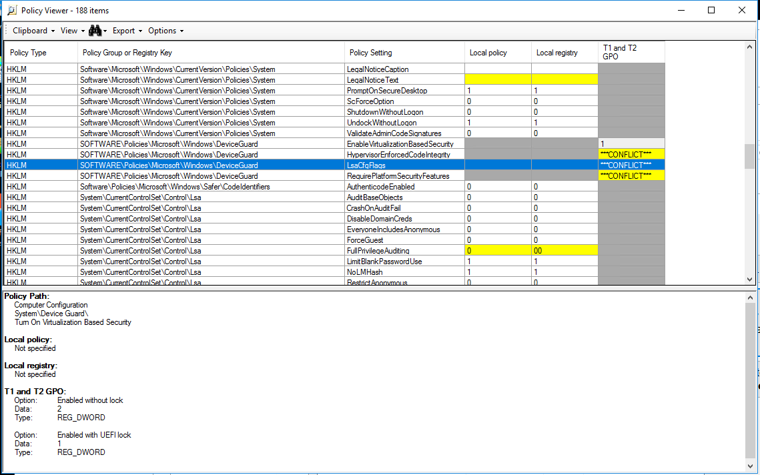
Microsoft Security Compliance Toolkit
Notes:
Using the Toolkit and Baselines Download the toolkit (PolicyAnalyzer.zip and LGPO.zip) along with the baselines for the relevant Windows versions (see download instructions below). You can then use the tools to:
Load an existing Group Policy Backup into Policy Analyzer, along with one or more downloaded baselines, for comparison;
Make edits to the existing Group Policy Backup within Policy Analyzer, and save the revised version;
Use LGPO to load the revised Backup into a host for testing; and
Restore the revised backup as the new Group Policy for deployment.
https://blogs.technet.microsoft.com/secguide/2017/06/15/security-compliance-manager-scm-retired-new-tools-and-procedures/

Slide 6
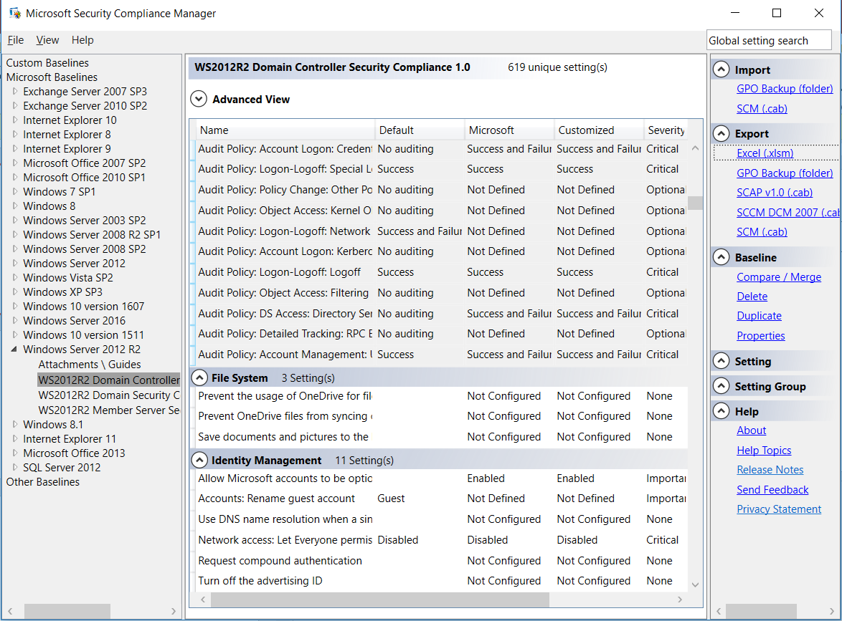
Once upon a time…
SCM
RIP Security Compliance Manager
This used to be a tool used to read and compare security baselines for OS per machine role (baselines for a DNS server, for a file server, for a DC, etc.)
This tool is no longer maintained, don’t use it unless you want to see the legacy recommendations

Slide 7
Security Settings and recommended values
The baselines contain the recommended values for each security setting
Microsoft’s website contains all explanations about the values
Vulnerability
Countermeasure
Potential impact
Notes:
Ref: https://docs.microsoft.com/en-us/windows/security/threat-protection/security-policy-settings/security-options

Slide 8
It’s all about GPOs
Security settings should be enforced through GPO
Security settings in the GPOs are always re-applied at an defined interval
Whereas non-security settings in GPOs are re-applied only if the GPOs have changed
The policy engine uses the version number of the GPO to determine if a change was made
Only domain administrators should be allowed to manipulate GPOs
If you can create and link a GPO, you control the security of the machines applying it
Notes:
By default group policies apply every 90 minutes (-30/+30 mins) and it’s every 5 minutes on domain controllers.

Slide 9
Windows and Active Directory audit
You can use Windows auditing to track all actions against the OS and AD
Audit needs to be enabled at the OS level
There are plenty of different audit categories to be granular
This can be enabled with GPO
SACLs have to be configured at the audited object level
You need the privilege SeSecurityPrivilege
Notes:
There are always two components to configure when one wants to use the audit. First, the audit has to be enabled for the category one whishes to audit. And then the SACL of the resource we want to audit has to be configured.
To see SACL, make sure you have the proper privilege on the target system: Manage auditing and security log https://docs.microsoft.com/en-us/windows/security/threat-protection/security-policy-settings/manage-auditing-and-security-log
Only the members of the built-in administrators group can see SACL on AD object by default. However, be extremely careful if you change this setting. When Microsoft Exchange is deployed in the domain, the installation program is adding the Exchange Servers groups to the DDCP. If you remove it by overriding it by another GPO, you will break the messaging system (Ref: http://technet.microsoft.com/en-us/library/hh377655(v=EXCHG.140).aspx).
The following script is creating an HTLM report of the SACL set on Active Directory objects: https://gallery.technet.microsoft.com/List-all-the-SACLs-of-1a16124e
Ref: Planning and deploying advanced security audit policies https://docs.microsoft.com/en-us/windows/security/threat-protection/auditing/planning-and-deploying-advanced-security-audit-policies

Slide 10
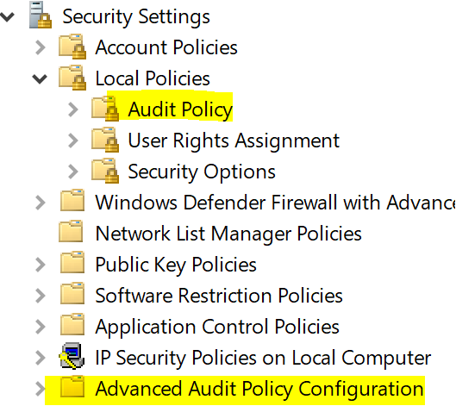
Once upon a time…
Legacy audit policy
There are two places to configure the audit on the OS
👎 Local Policies/Audit Policy is the legacy way
👍 Advanced Audit Policy Configuration is the way to go since Windows Server 2008
Notes:
In the security option of the GPO, there is a setting called: “Audit: Force audit policy subcategory settings (Windows Vista or later) to override audit policy category settings”. When this is enabled (and this is the case by default), what is set on the legacy audit policy is not longer considered.
Ref: https://docs.microsoft.com/en-us/windows/security/threat-protection/security-policy-settings/audit-force-audit-policy-subcategory-settings-to-override

Slide 11
Advanced Audit Policy Configuration 1/2
AUDIT POLICY CATEGORY | SUBCATEGORY | AUDIT EVENTS
Account Logon | Credential Validation | Success and Failure
Account Management | Security Group Management | Success and Failure
 | User Account Management | Success and Failure
 | Computer Account Management | Success and Failure
 | Other Account Management Events | Success and Failure
Detailed Tracking | Process Creation | Success
 | Process Termination | Success
Logon/Logoff | Logon | Success and Failure
 | Logoff | Success
 | Other Logon/Logoff Events | Success and Failure
 | Special Logon | Success and Failure
 | Account Lockout | Success
Notes:
Above is a short list of the audit settings available with an example of recommended settings
Complete list is available here: Advanced security audit policy settings https://docs.microsoft.com/en-us/windows/security/threat-protection/auditing/advanced-security-audit-policy-settings
The following examples are taking from the following online reference: https://mva.microsoft.com/en-us/training-courses/defending-active-directory-against-cyberattacks-16327

Slide 12
Advanced Audit Policy Configuration 2/2
AUDIT POLICY CATEGORY | SUBCATEGORY | AUDIT EVENTS
Object Access | File Share | Success
 | Removable Storage | Success
Policy Change | Audit Policy Change | Success and Failure
 | MPSSVC Rule-Level Policy Change | Success and Failure
 | Other Policy Change Events | Success and Failure
 | Authentication Policy Change | Success and Failure
 | Authorization Policy Change | Success and Failure
System | Security State Change | Success and Failure
 | Security System Extension | Success and Failure
 | System Integrity | Success and Failure
Notes:
Note that the only way to get the effective audit policy on a system is to run the following command line locally in an elevated prompt: auditpol /get /category:*

Slide 13
Interesting events 1/8
Application Crashes
System or Service Failures
EVENT | EVENT ID | EVENT LOG | EVENT SOURCE
App Error | 1000 | Application | Application Error
App Hang | 1002 | Application | Application Hang
BSOD | 1001 | System | Windows Error Reporting
WER | 1001 | Application | Windows Error Reporting
EVENT | EVENT ID | EVENT LOG | EVENT SOURCE
Windows Service Fails or Crashes | 7022-7024, 7026, 7031, 7032, 7034 | System | Service Control Manager
Notes:
Application Crashes
Application crashes may warrant investigation to determine if the crash is malicious or benign. Categories of crashes include Blue Screen of Death (BSOD), Windows Error Reporting (WER), Application Crash and Application Hang events. If the organization is actively using the Microsoft Enhanced Mitigation Experience Toolkit (EMET), then EMET logs can also be collected.
System or Service Failures
System and Services failures are interesting events that may need to be investigated. Service operations normally do not fail. If a service fails, then it may be of concern and should be reviewed by an administrator. If a Windows service continues to fail repeatedly on the same machines, then this may indicate that an attacker is targeting a service.

Slide 14
Interesting events 2/8
Windows Update Failures
Clearing Event Logs
EVENT | EVENT ID | EVENT LOG | EVENT SOURCE
Windows Update Failed | 20, 24, 25, 31, 34, 35 | Microsoft\Windows\WindowsUpdateClient\Operational | WindowsUpdateClient
Hot patching Failed | 1009 | Setup | Servicing
EVENT | EVENT ID | EVENT LOG | EVENT SOURCE
Event Log was Cleared | 104 | System | Eventlog
Audit Log was Cleared | 1102 | Security | Eventlog
Notes:
Windows Update Failures
A machine must be kept up to date to mitigate known vulnerabilities. Although unlikely, these patches may sometimes fail to apply. Failure to update issues should be addressed to avoid prolonging the existence of an application issue or a vulnerability in the operating system or an application.
Clearing Event Logs
It is unlikely that event log data would be cleared during normal operations and it is likely that a malicious attacker may try to cover their tracks by clearing an event log. When an event log gets cleared, it is suspicious. Centrally collecting events has the added benefit of making it much harder for an attacker to cover their tracks. Event Forwarding permits sources to forward multiple copies of a collected event to multiple collectors thus enabling redundant event collection. Using a redundant event collection model can minimize the single point of failure risk.

Slide 15
Interesting events 3/8
Software and Service Installation
EVENT | EVENT ID | EVENT LOG | EVENT SOURCE
New Kernel Filter Driver | 6 | System | FilterManager
New Windows Service | 7045 | System | Service Control Manager
New MSI File Installed | 1022,1033 | Application | MsiInstaller
Update Package Installed | 2 | Setup | Servicing
Windows Update Installed | 19 | System | WindowsUpdateClient
Notes:
Software and Service Installation
As part of normal network operations, new software and services will be installed, and there is value in monitoring this activity. Administrators can review these logs for newly installed software or system services and verify that they do not pose a risk to the network.

Slide 16
Interesting events 4/8
Windows Firewall
EVENT | EVENT ID | EVENT LOG | EVENT SOURCE
Firewall Rule Add | 2004 | Microsoft\Windows\Windows Firewall With Advanced Security\Firewall | Windows Firewall With Advanced Security
Firewall Rule Change | 2005 | Microsoft\Windows\Windows Firewall With Advanced Security\Firewall | Windows Firewall With Advanced Security
Firewall Rules Deleted | 2006, 2033 | Microsoft\Windows\Windows Firewall With Advanced Security\Firewall | Windows Firewall With Advanced Security
Firewall Failed to Load Group Policy | 2009 | Microsoft\Windows\Windows Firewall With Advanced Security\Firewall | Windows Firewall With Advanced Security
Notes:
Windows Firewall
If client workstations are taking advantage of the built-in host-based Windows Firewall, then there is value in collecting events to track the firewall status. For example, if the firewall state changes from on to off, then that log should be collected. Normal users should not be modifying the firewall rules of their local machine.

Slide 17
Interesting events 5/8
Account Usage
EVENT | EVENT ID | EVENT LOG | EVENT SOURCE
Account Lockouts | 4740 | Security | Microsoft Windows Security Auditing
User Added to Privileged Group | 4728, 4732, 4756 | Security | Microsoft Windows Security Auditing
Security Enabled Group Modification | 4735 | Security | Microsoft Windows Security Auditing
Successful User Account Logon | 4624 | Security | Microsoft Windows Security Auditing
Failed User Account Logon | 4625 | Security | Microsoft Windows Security Auditing
Account Logon with Explicit Credentials | 4648 | Security | Microsoft Windows Security Auditing
Notes:
Account Usage
User account information can be collected and audited. Tracking local account usage can help detect Pass the Hash activity and other unauthorized account usage. Additional information such as remote desktop logins, users added to privileged groups, and account lockouts can also be tracked. User accounts being promoted to privileged groups should be audited very closely to ensure that users are in fact supposed to be in a privileged group. Unauthorized membership in privileged groups is a strong indicator that malicious activity has occurred.

Slide 18
Interesting events 6/8
Kernel Driver Signing
EVENT | EVENT ID | EVENT LOG | EVENT SOURCE
Detected an invalid image hash of a file | 5038 | Security | Microsoft Windows Security Auditing
Detected and invalid page hash of an image file | 6281 | Security | Microsoft Windows Security Auditing
Code Integrity Check | 3001-3004, 2010, 3023 | Microsoft\Windows\CodeIntegrity\Operational | Microsoft Windows CodeIntegrity
Failed Kernel Driver Loading | 219 | System | Microsoft Windows Kernel PnP
Notes:
Kernel Driver Signing
Introduction of kernel driver signing in the 64-bit version of Windows Vista significantly improves defenses against insertion of malicious drivers or activities in the kernel. [52] Any indication of a protected driver being altered may indicate malicious activity or a disk error and warrants investigation.

Slide 19
Interesting events 7/8
Group Policy Errors
EVENT | EVENT ID | EVENT LOG | EVENT SOURCE
Detected an invalid image hash of a file | 5038 | Security | Microsoft Windows Security Auditing
Detected and invalid page hash of an image file | 6281 | Security | Microsoft Windows Security Auditing
Code Integrity Check | 3001-3004, 2010, 3023 | Microsoft\Windows\CodeIntegrity\Operational | Microsoft Windows CodeIntegrity
Failed Kernel Driver Loading | 219 | System | Microsoft Windows Kernel PnP
Notes:
Group Policy Errors
Management of domain computers permits administrators to heighten the security and regulation of those machines with Group Policy. The inability to apply a policy due to a group policy error reduces the aforementioned benefits. An administrator should investigate these events immediately.

Slide 20
Interesting events 8/8
Windows Defender Activities
EVENT | EVENT ID | EVENT LOG | EVENT SOURCE
Scan Failed | 1005 | Microsoft\Windows\Windows Defender\Operational | Microsoft Windows Defender
Detected Malware | 1006 | Microsoft\Windows\Windows Defender\Operational | Microsoft Windows Defender
Action on Malware Failed | 1008 | Microsoft\Windows\Windows Defender\Operational | Microsoft Windows Defender
Failed to remove item from quarantine | 1010 | Microsoft\Windows\Windows Defender\Operational | Microsoft Windows Defender
Failed to update signatures | 2001 | Microsoft\Windows\Windows Defender\Operational | Microsoft Windows Defender
Failed to update engine | 2003 | Microsoft\Windows\Windows Defender\Operational | Microsoft Windows Defender
Reverting to last known good set of signatures | 2004 | Microsoft\Windows\Windows Defender\Operational | Microsoft Windows Defender
Real-Time Protection failed | 3002 | Microsoft\Windows\Windows Defender\Operational | Microsoft Windows Defender
Unexpected Error | 5008 | Microsoft\Windows\Windows Defender\Operational | Microsoft Windows Defender
Notes:
Windows Defender Activities
Spyware and malware remain a serious problem and Microsoft developed an antispyware and antivirus, Windows Defender, to combat this threat. [53] Any notifications of detecting, removing, preventing these malicious programs should be investigated. In the event Windows Defender fails to operate normally, administrators should correct the issue immediately to prevent the possibility of infection or further infection. If a third-party antivirus and antispyware product is currently in use, the collection of these events is not necessary.

Slide 21
Where are events generated?
Workstation
Name: WKS
IP: 10.10.0.8
Domain controller
Name: VDC01
IP: 10.10.0.4
User
Name: Norma Luser
UPN: normaluser@verenatex.com
File Server
Name: FILE01
IP: 10.10.0.6

Slide 22
Machine boots
Kerberos TGT Request
Event ID: 4748
Kerberos Authentication Service
Event ID: 4624
Logon
Kerberos TGT Response
Event ID: 4769
Kerberos Service Ticket Operations
Kerberos TGS Request
ldap/VDC01.verenatex.com/verenatex.com
Event ID: 4688
Process Creation
Kerberos TGS Response
Event ID: 4624
Logon
LDAP Connexion
Event ID: 4634
Logoff
LDAP Session ends
Notes:
The machines starts and gets a TGT for itself.
Once the TGT is obtained, the GPO service starts and get the GPO list over LDAP etc…

Slide 23
Norma runs the following command on WKS: net use F: \\FILE01.verenatex.com\c$ /user:V\piaudonnmsdn
Event ID: 4688
Process Creation
SMB:C; Negotiate
SMB:R; Negotiate
Event ID: 4768
Kerberos Authentication Service
Kerberos TGT Request
Event ID: 4648
Logon
Kerberos TGT Response
Event ID: 4769
Kerberos Service Ticket Operations
Kerberos TGS Request
CIFS/FILE01.verenatex.com
Kerberos TGS Response
Event ID: 4624
Logon
SMB:C; Session Setup
Event ID: 4689
Process Termination
SMB:R; Session Setup

Slide 24
Norma runs the following command on WKS: net use F: \\10.10.0.6\c$ /user:V\piaudonnmsdn
Event ID: 4688
Process Creation
SMB:C; Negotiate
… then SET UP…
SMB:R; Negotiate
… then STATUS_MORE_PROCESSING_REQUIRED SESSION SETUP
RPC EPM
… then Netlogon(NRPC)
Event ID: 4776
Credential Validation
Event ID: 4624
Logon
RPC responses
(secure channel stuff)
SMB:R, Session Setup
Event ID: 4648
Logon
SMB:C, Tree Connect
Event ID: 4689
Process Termination

Slide 25
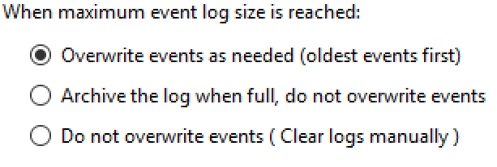
Event logs management
The maximum size for an event log is 4Gb
It does not mean you should set it to 4Gb
Performance of log queries might be affected
Better use specific filters when querying large logs
You can configure the log behavior when full
Notes:
Ref: https://docs.microsoft.com/en-us/previous-versions/windows/it-pro/windows-server-2008-R2-and-2008/cc766178(v%3dws.11)

Slide 26
Once upon a time…
The maximum size for the logs used to be 300Mb
All event logs together had to fit in 300Mb! (not anymore)
Operating system | Recommended maximum size for each log (kilobytes) | Recommended maximum total size for all logs (kilobytes) | Approximate maximum logging rate (events per second) | Recommended maximum log size to view (kilobytes)
Windows Server 2003, 32-bit versions | 300,000 | 300,032 | 1,000 | 300,000
Windows Server 2003, 64-bit versions | 4,194,240 | 16,776,960 | 5,000 | 4,194,240
Windows Vista and newer, 32-bit versions | 4,194,240 | 16,776,960 | 2,000 | 4,194,240
Windows Vista and newer, 64-bit versions | 4,194,240 | 16,776,960 | 5,000 | 4,194,240
Notes:
Ref: https://support.microsoft.com/en-ca/help/957662/recommended-settings-for-event-log-sizes-in-windows

Slide 27
Query the event logs
Windows event are XML structure and can be filtered using Xpath
Example 1
Event[
System[
EventID=4624
] and
EventData[
Data[@Name="LmPackageName"]="NTLM V1"
and
Data[@Name="TargetUserSid"]!="S-1-5-7"
]
]
Example 2
*[System[(EventID=4732) or (EventID=4733) or (EventID=4728) or (EventID=4729) or (EventID=4756) or (EventID=4757)]] and *[EventData[Data[@Name="TargetUserName"] and (Data="Enterprise Admins") or (Data="Schema Admins") or (Data="Domain Admins") or (Data="Administrators") or (Data="Account Operators") or (Data="Server Operators") or (Data="Backup Operators") or (Data="Print Operators") or (Data="Enterprise Key Admins")]]
Example 3
Event[
System[
(EventID=5136 or EventID=5137 or EventID=5141)
] and EventData[
(Data[@Name="ObjectClass"]="groupPolicyContainer" or Data[@Name="AttributeLDAPDisplayName"]="gPLink")] ]
Notes:
Example 1
All successful NTLMv1 authentications against the local system which are not coming from the SID for Anonymous Logon
Example 2
All administrative groups modification.
Example 3
All modification of GPO objects or of gPlink (GPO links on the domain, on OUs or sites).
It is not a full implementation of the Xpath language. See the following article for full reference: https://msdn.microsoft.com/en-us/library/windows/desktop/dd996910(v=vs.85).aspx

Slide 28
Collect and centralize the logs
Ideally you need a Security Information and Event Management system
It collects the events you want, centralizes them, correlates the events and offers efficient ways to query the data
Make sure you enable the audit policy in a way the reports and detection capabilities of the tools are met
Make sure it collects the events you need for your reports (and make sure it does not truncate data too early in the vent payload as relevant data sometimes lays in the detail section)
SIEM
Notes:
From Wikipedia: In the field of computer security, security information and event management (SIEM) software products and services combine security information management (SIM) and security event management (SEM). They provide real-time analysis of security alerts generated by applications and network hardware.
Ref: https://en.wikipedia.org/wiki/Security_information_and_event_management

Slide 29
Event forwarding
WEF
Windows Event Forwarding
Cheap
Built-in
Agent-less
Easy to configure (GPO)
Can be used in combination of a SIEM (complementary)
Pull or Push
It is better to let the machines push their events
When using pull, you need to configure permissions for a service account on all machines to remotely retrieve specific events
It uses WinRM
Notes:
To configure WinRM for event forwarding, you just need to run one command on the systems: WINRM QC (and/or GPOs).

Slide 30
Professor Useful
By default the Event forwarding plugin cannot read the security event log
It runs under “Network service” and “Network service” does not have the SeSecurityPrivilege privilege
Network service needs to be added to the “Event Log Readers” group of all the machines
Or you can use a GPO to change the default security of the security eventlog to grant “Network Service” directly
Notes:
The technical steps to modify the DACL of the security event logs are available here: https://support.microsoft.com/en-ca/help/323076/how-to-set-event-log-security-locally-or-by-using-group-policy

Slide 31
WEF components
Domain Controller
Hosts GPOs
Collection Server
Hosts subscriptions - XPath filtering
- Group filtering
GPO
Define where the subscriptions are
Create subscriptions on collection
Create a GPO that will define where the collection servers to the clients are
The clients apply the GPO, and start forwarding events according to the subscription filter
Domain joined machines
Apply GPOs
Notes:
You can have one or more collection servers, you need to create subscriptions on the collection servers. It is done within the graphical interface of the Event Log Viewer.
The GPO can also reference one or more collection servers, it defines the HTTP URL at which clients need to check their subscriptions. The URL can also contain metadata such as the frequency at which the clients will check for new subscriptions.
The clients apply their GPOs, connect to the collection server over WinRM to check the subscription. Check if they are applicable (looking at the security filtering) and then retrieve the filter and start forwarding events at the speed defined in the advanced options.
Note that it is possible to use WEF with workgroup machines using certificate based authentication.

Slide 32
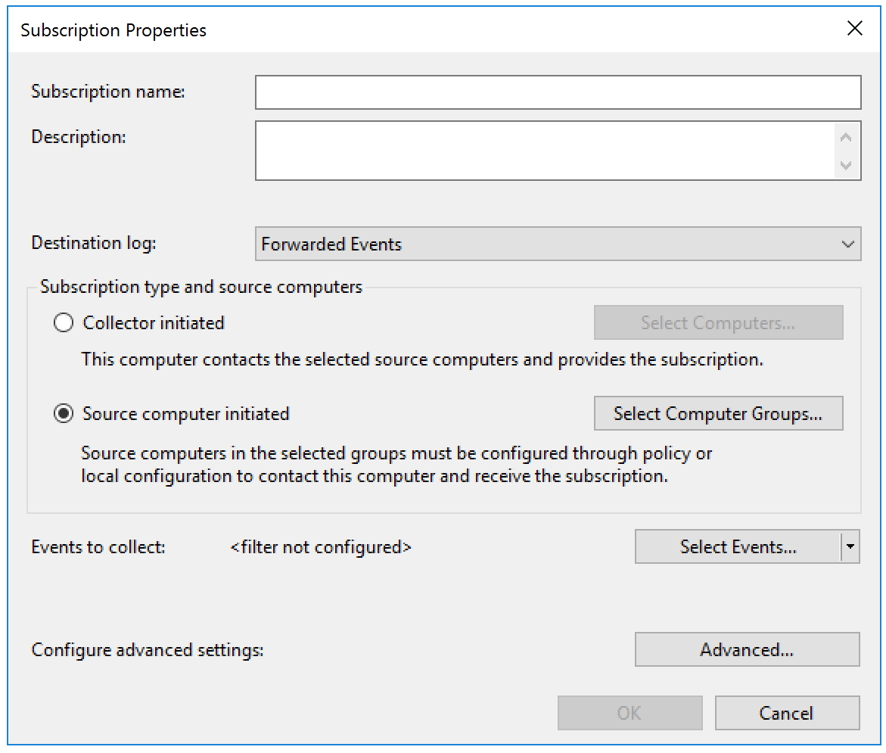
Event forwarding subscription
Display name and description
Destination of the logs on the collection server
Subscription type (pull or push) you want the Source initiated (the clients push)
Event filter
Options such as priority of the plugin and HTTPs
Notes:
Try to use a precise description.
For the filter, you can use the wizard or you can use an Xpath filter.
The Advanced feature lets you enable HTTPs for the event forwarding. Note that even if you are not using HTTPs, the payloads of the event forwarding network messages are already encrypted at the application level (within the SOAP envelop the WinRM protocol uses).

Slide 33
Event forwarding limitations
Windows Event Forwarding forwards events and stores them in an event log, there is no built-in reporting features
Although you can export events in HTML or CSV format with just one line of PowerShell
There is no alerting mechanism if a suspicious event is forwarded
You will need to review the forwarded logs manually (create views and queries)
Or you can create Event Triggers! There are actions which are executed when a specific event shows up in an event log
Notes:
Example of PowerShell:
Get-WinEvent -LogName security -MaxEvents 100 | ConvertTo-Html | Out-File SecurityLogs.html
This one is very basic, it is better to expand the properties to see the details of the event instead of just vomiting everything in a poor HTML file…
Additional information about event triggers can be found there:
Trigger a PowerShell Script from a Windows Event https://blogs.technet.microsoft.com/wincat/2011/08/25/trigger-a-powershell-script-from-a-windows-event/
Reference The Event That Triggered Your Task https://blogs.technet.microsoft.com/otto/2007/11/09/reference-the-event-that-triggered-your-task/
Note that Event Forwarding is also available on Windows XP and Windows Server 2003 R2. However, WinRM works slightly differently and there are some customizations to make if you want to add them into your event forwarding scope (for example, the WinRM remote port is different).

Slide 35
List of abbreviations
SCM Security Compliance Manager
SIEM Security Information and Event Management
WEF Windows Event Forwarding

